Slide 1
THE BRAZILIANS
House Prices:
Advanced Regression Techniques
Guilherme Strachan, Ben Witte, Felipe Santos, Sanjay Pamnani

Slide 2
Our Results
Kaggle RMSE 0.1214
Ranking 1,007
Final model was ensemble of GMB and Lasso
55% GBM
45% Lasso
Learning – MASSIVE!!
Price 12.4% off

Slide 3
Problem Statement and Challenges
Provided 79 explanatory variables that describe many aspects of residential sold homes in Ames, Iowa between 2006 and 2010
Tasked with predicting the sales price for each house
Classic regression problem however there are a large number of features/dimensions many of which are categorical variables
Additionally the data has missing values, outliers, as well as several features that do not conform to a Gaussian distribution

Slide 4
Our Approach
Technical Approach
EDA on the dataset to understand
Missingness
Distribution of numeric and categorical features
Focused on preparing data for feature engineering and modeling
Market Approach
Also considered the residential real estate market dynamics and the overall economical cycle for the period under consideration
Included Case-Shiller housing index as well as some specific feature engineering to account for seasonality and cyclicality

Slide 5
Missingness and Imputation Approach
Data helped guide imputation process
Imputed ’SBrkr’ for missing Electrical value as all homes constructed in that period had Standard Circuit Breakers
Imputed None and 0 for missing value on assumption that house lacked those specific features
Example: Missing Masonry Veneer Type and Masonry Veneer Area
Dropped following features because they were irrelevant, had very limited number of values or did not have sufficient variance
Id, Alley, BsmtCond, BsmtFinType2, GarageQual, GarageCond, PoolQC, Fence, MiscFeature

Slide 6
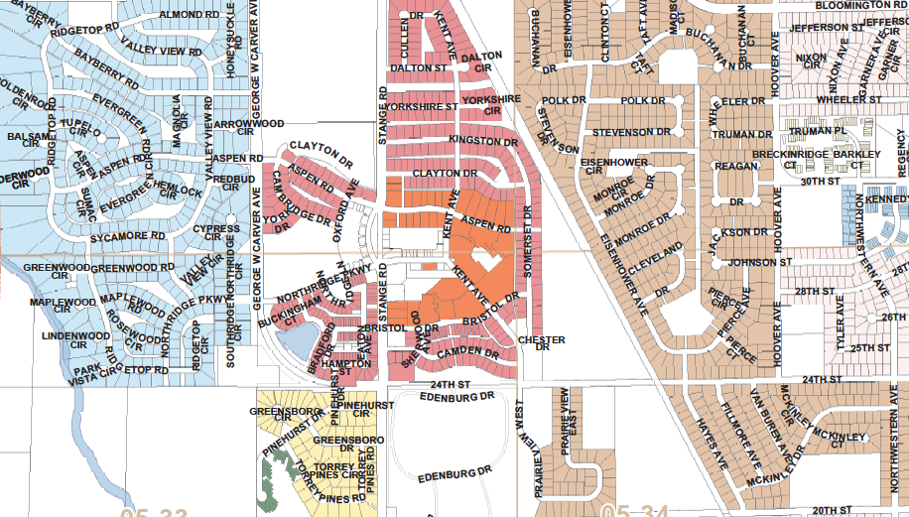
Missingness and Imputation: LotFrontage
Dependent on 2 features:
Lot Config
Cul-de-sac
2-3 sides
Lot Shape
Regular
Irregular
Grouped by features, aggregated median for lot frontage

Slide 7

Feature Engineering
Normalization, by the grace of Gui
Looped normalized testing for all continuous numeric variables
If non-normal, log of variable
Sample code
skewness = stats.skew(x[column])
if skewness > .70:
x[column] = np.log(x[column] + 1)

Slide 8
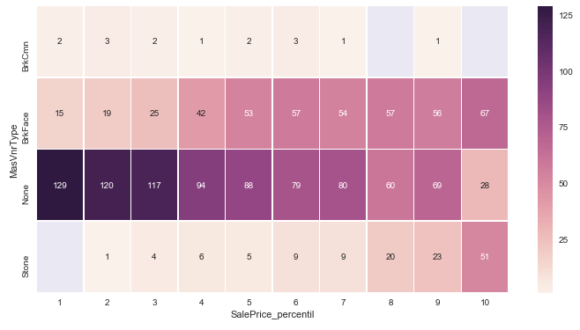
Feature Engineering
Heat map plotted along with percentile of sales price helped identify categorical features for engineering and dummification

Slide 9
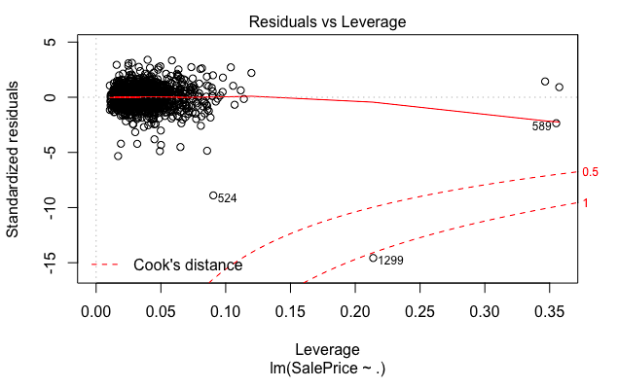
Outliers
We identified and removed two outliers from the training data set

Slide 10
Models Dumped!!
Random Forest
XGBoost
Ridge
ElasticNet
K-means
K-mode
MLR
Forward/Backward Selection

Slide 11
Best Performing Models
GBM
Lasso
Best prediction
R2 of 0.92
Cross-validation RMSE of 0.11
Feature selection
Full data set outperformed engineered data set
Model used 36 of 323 variables
Q4 seasonality penalty
Case-Shiller housing index to capture housing market cycle
Second best prediction
R2 of 0.94
Cross-validation RMSE of 0.115
Feature selection
Full data set outperformed engineered set
Used 189 of 323 features
Used several exponential features
Final submission was an ensemble of GBM and Lasso

Slide 12
Feature Importance
GBM
Lasso
Our two leading models gave importance to differing sets of features

Slide 13
Residuals Plot
GBM
Lasso
GBM does a better job of predicting values at the lower end while Lasso has a much stronger clustering of predictions around its center

Slide 14
Lessons
The Problem with Manual Feature Engineering & Selection
Could a Hybrid combination of manual and algorithmic be best fit?
Data Process Flow
Iterative approach – manual engineering, algorithmically influenced, repeat
Feature importance
The Power of Lasso! (and Gal Gadot)
K means and Categorical variables
Nope – use K Modes
“Next time will be easier.”
“I’ll be back”

Slide 15
Next Steps
Feed models both the full data set as well as features that were engineered and allow model to rank feature importance
Use Stacking to combine 4-5 best performing models
Investigate if external data sources can help increase explanatory power of the models
Eg: Interest rates, employment data, income, etc.

